Slide 1
Module:5 Chapter:1
INFORMATION RETRIEVAL AND
LEXICAL RESOURCES

Slide 2
INTRODUCTION:
IR mainly deals with the organization, storage, retrieval and evaluation of information relevant to a user’s query.
Traditionally, IR system are not expected to return the actual information.
An IR system does not inform the user on the subject of her inquiry. It merely informs on the existence and where about of documents relating to her request.

Slide 3
Design features of information retrieval system:
Information need
USER
QUERY
DOCUMENTS
IR SYSTEM
Relevant documents

Slide 4
The actual text of the document is not used in the retrieval process.
The processing of transforming document text to some representation of it known as “Indexing”
the two most commonly used text operation are stop word elimination and stemming.
Zipf’s law can be applied to further reduce the size of index set.
A number of term-weighting schemes have been proposed in the literature over the years.

Slide 5
Indexing:
A collection of raw documents is usually transformed into an easily accessible representation. This process is know as indexing .
The word ’term’ can be a single word or multiword phrases.
Ex:The sentence, Design features of information retrieval system, can be represented as follow:
Design,Features,information,retrieval,system
It can also be represented by the set of terms:
Design,Features,information, information retrieval system.
In text retrieval conference(TREC),the method used for phrase extraction is as follow:
1)Any pair of adjacent non-stop words regarded a potential phrase.
2)The final list of phrases is composed of those pairs of words that occur in, say 25 or more documents in the document collection.

Slide 6
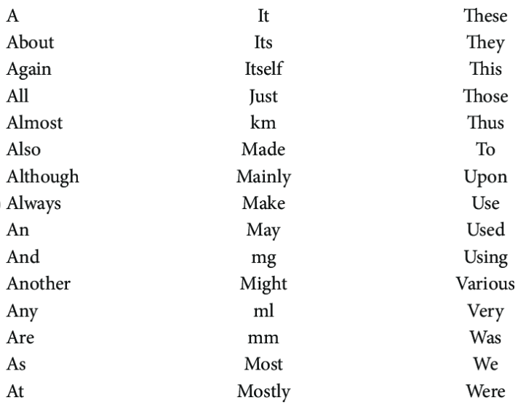
Eliminating stop words:
The lexical processing of index terms involves elimination of stop words.
Stop words are high frequency words which have little semantic weight and are thus, unlikely to help in retrieval.
Drawback of elimination stop words is that it can some times result in the elimination of useful index terms, for instance the stop word A in vitamin A .
Sample stop words in English

Slide 7
STEMMING:
Stemming normalizes morphological variants, though in a crude manner, by removing affixes from the words to reduce them to their stem, eg:the words compute, computing, computes and computer, are all be reduced to same word stem, comput.
The keywords or terms used to represent text are stems, not the actual words.
The stemmed representation of the text, Design features of information retrieval system is
{design,featur,inform,retriev,system}

Slide 8
Zipf's law
Zipf made an important observation on the distribution of words in natural languages. This observation has been named Zipf’s law.
Zipf’s law says that the frequency of words multiplied by their ranks in a large corpus is more or less constant. More formally,
Frequent*rank=constant
frequency
Rank order

Slide 9
Information Retrieval Models
IR system consists of a model for documents, a model for queries, and a matching function which compares queries to documents.
Several different IR models have been developed.
These models can be classified as follows:
1)Classical models of IR
2)Non-classical models of IR
3)Alternative models of IR

Slide 10
The three IR models –Boolean,vector,and Probabilistic-are based on mathematical knowledge that is easily recognized and well understood.
All the existing commercial system are based on the mathematical models of IR.That is why they are called classical models of IR.
Non-classical models perform retrieval based on principles other than those used by classical models, i.e similarity, probability and Boolean operation.
The third category of IR models, namely alternative models, are actually enhancements of classical models, making use of specific techniques from other fields.

Slide 11
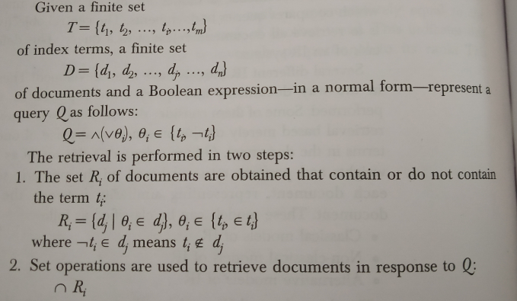
1.Classical Information Retrieval Models
Boolean Model: An inverted file is a list of keywords and identifiers of the documents in which they occur.
Users are required to express their queries as a Boolean expression consisting of keywords connected with Boolean Logical Operators(AND,OR,NOT).

Slide 12
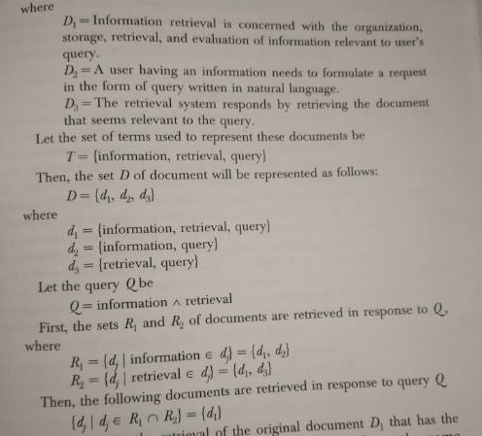
Example: Let the set of original documents be D={D1,D2,D3)

Slide 13
Probabilistic Model: applies a probabilistic framework to IR.
Retrieval depends on whether probability of relevance of a document is higher than that of non-relevance, i.e whether it exceeds a threshold value.
More formally,if P(R/d) is the probability of relevance of a document d,for query q,and P(I/d) is the probability of irrelevance of a document d,then the set of documents retrieved in response to the quety a is an follows:
S={dj|P(R/dJ)}P(R/dj)≥α
The probabilistic model, like the vector model, can produce results that partly match the user query.

Slide 14
Vector Space Model: its one of the most well-studied retrieval model.
Each document is characterized by a Boolean or numerical vector.
These vectors are represented in a multi-dimensional space, in which each dimension corresponds to a distinct term in the corpus of documents.
Given a finite set of documents
D={d1,d2,d3,d4………dn}
And finite set of m terms
T={t1,t2,t3,t4………tm}
Each document is represented by a column vector of weights as follows:
(w1j, w2j, w3j, w4j,…. Wmj)t

Slide 15
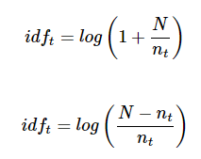
Term weighting:
Term weighting means the weights on the terms in vector space. Higher the weight of the term, greater would be the impact of the term on cosine. More weights should be assigned to the more important terms in the model.
Inverse Document Frequency (idf) This is another form of document frequency weighting and often called idf weighting or inverse document frequency weighting. The important point of idf weighting is that the term’s scarcity across the collection is a measure of its importance and importance is inversely proportional to frequency of occurrence.
Mathematically,

Slide 16
A simple automatic method for obtaining indexed representation of the documents is a follows:
Step 1: Tokenization: this extracts individual terms form a document, converts all the letters to lower case, and removes punctuation marks.
Step 2: Stop word elimination: this removes words that appear more frequently in the document collection.
Step 3: Stemming: This reduces the remaining terms to their linguistic root, to obtain the index terms.
Step 4: Term weighting: This assigns weights to terms according to their importance in the document, in the collection, or some combination of both.

Slide 17
2.Non-classical models of IR
Are based on principles other than similarity probability, Boolean operations, etc.,
The information logic model is based on a special logic technique called logical imaging.
Given any two sentences x and y, a measure of the uncertainty of y->x relative to given data set id determined by the minimal extent to which one has to add information to the data set in order to establish the truth of y->x.
The interaction IR Model was first introduced in 1992 this model, the documents are not isolated instead, they are interconnected.

Slide 18
3.Alternative Models of IR
Cluster Model: is an attempt to reduce the number of matches during retrieval.
State the cluster hypothesis that explain why clustering could prove efficient in IR.
Closely associated documents tend to be relevant to the same clusters.
Clustering can be applied on terms instead of documents.
Thus terms can be grouped to form classes of co-occurrence terms.
Cluster generation method based on similarity matrix.
Let D={d1,d2,d3….dj….dm} be a finite set of documents and let E=(eij)n,n be the similarity matrix.
The set of cluster thus obtained is
C={C1,C2,C3…..Ck….Cp}
Representation vector for a cluster Ck is

Slide 19
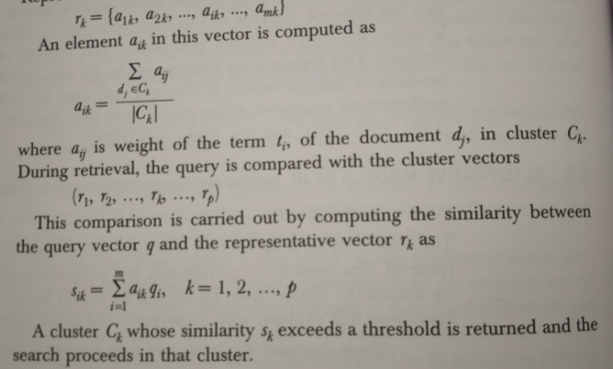

Slide 20
Fuzzy Model: The document is represented as a fuzzy set of terms,i.e, a set of pairs[ti,μ(ti)],where μ is the membership function.
The membership degree expresses the significance of term to the information contained in the document.
Where D={d1,d2,……dj,….dn}
Can thus be represented as a vector of term weights, as in the following vector space model
(w1j,w2j,w3j,…..wij,….wmj)
Dj to the subject area represented by term ti.each term ti is itself represented by a fuzzt set fi in the domain of documents given by
fi={(dj,wij)}|i=1,….,m;j=1,….n

Slide 21
For the single-term query q=tq those documents from the fuzzy set fq={(dj,wiq)},are retrieved for which exceeds a given threshold. The threshold may also be zero.
Consider the case of an AND query q=tq1^ tq2
First, the fuzzy sets fq1 and fq2 are obtained and then, their intersection is obtained, using the fuzzy intersection operator
fq1˅ fq2=min{(dj,wiq1),(dj,wiq)}

Slide 22
Latent Semantic indexing Model:is the application of single value decomposition to IR.
The document collection is the first processed to get m*n term-by –document matrix where m is the number of index terms and n is the total number of documents in the collection.
Single value decomposition(SVD) of the term-by-document matrix is then computed.
Using SVD,the matrix is represented as aproduct of three matrices
W=TSD T

Slide 23
EVALUATION OF THE IR SYSTEM:The Evaluation of IR system is the process of assessing how well a system meets the information needs of its users.
Evaluation models can broadly classified as system driven models and user-centered models.
System driven models (Cleverdon et al.1966) measure how well a system ranks documents
user-centered models. Measure user satisfaction.
Cleverdon listed the following six criteria that can be used for evaluation:
1.Coverage of the collection:the extent to which the system
2.Time lag:the time that elapses between submission of a query and getting back the response
3.Presentation format

Slide 24
4.User effort:the effort made by the user to obtain relevant information.
5.Precision: the proportion of retrieved documents that are relevant.
6.Recall:the Proportion of relevant documents that are retrieved.
The main goal of IR is to search for documents that arew relevant to a user’s query.

Slide 25
Relevance:
Relevance is subjective in nature,i.e it depends on the individual judgements of users.
Given a query the same document may be judged as relevant by one user and non-relevant by another.
It is not possible to measure this ‘true relevance’bcoz no human can read all documents in a collection and provide a relevance assessment.
A number of relevance frameworks have been proposed by Saracevic(1996)
This includes System, communication, psychological and situational frameworks.

Slide 26
Effective Measures:
Effectiveness is purly a measure of the ability of a system to satisfy the user in terms of the relevance of documents retrieved.
A number of measures have been proposed to quantify effectiveness.
Precision and Recall: Precision: is defined as the proportion of relevant documents in a retrieved set.
Recall:is the proportion of relevant documents in a collection that have actually been retrieved.
Precision and Recall can be computed as follows:

Slide 27
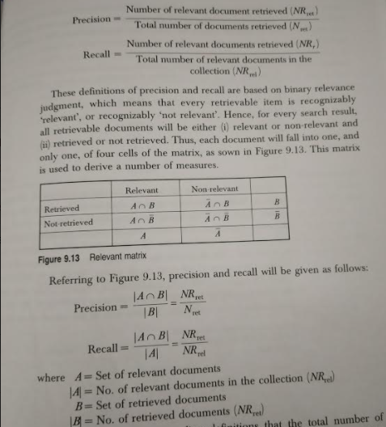

Slide 28
User- centered Evaluation:
A number of measures have been proposed for interactive IR including relative relevance(RR),ranked half life(RHL) and cumulated gain(CG)
The subjective nature and attempts have been made to highlighted and attempts have been made to integrate cognitive theory into IR evaluation.
The system to be compared must be equally well-developed and equipped with the appropriate user interface.

Slide 29
Module:5 Chapter:2
Lexical Resources

Slide 30
Introduction:
This chapter introduces some of the freely available resources.
In purticular ,we discuss lexical resources such as wroldNet and FrameNet,and tools such as stemmers, taggers and parsers and freely available test corpuses for various text-processing application.

Slide 31
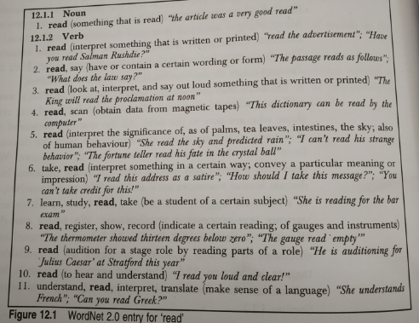
WordNet
WordNet is the lexical database i.e. dictionary for the English language, specifically designed for natural language processing. Synset is a special kind of a simple interface that is present in NLTK to look up words in WordNet.

Slide 32
Applications of WordNet
WordNet has been used for a number of purposes in information systems, including word-sense disambiguation, information retrieval, automatic text classification, automatic text summarization, machine translation and even automatic crossword puzzle generation.
Concept identification in natural language: Wordnet can be used to identify concepts pertaining to a term, to suit them to full semantic richness and complexity of a given information need.
Word sense disambiguation:Wordnet combines features of a number of the other resoureces commonly used in disambiguation work.

Slide 33
Automatic query expansion:can be used to epand queries so that the search for a document is not confined to the pattern-matching of query terms,but also covers synonyms.
Document structuring and categorization: the semantic information extracted from WordNet, and WordNet conceptual representation of knowledge, have been used for text categorization.
Document summarization: utilizes information from WordNet to compute lexical chains.

Slide 34
Frame Net
Is a large database of semantically annotated English sentences.
It defines a tag set of semantic roles called the frame element.
The word that invokes a frame is called target word or predicate, and the participant entities are defined using semantic roles, which are called frame elements.
Each frame contains a main lexical item as predicate and associated frame-specific semantic roles,such as AUTHORITIES,TIME and SUSPECT in the ARREST frame,called frame elements.

Slide 35
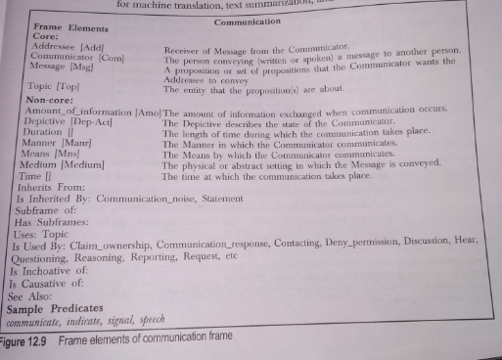

Slide 36
Frame Net applications
FrameNet has proven to be useful in a number of computational applications, because computers need additional knowledge in order to recognize that "John sold a car to Mary" and "Mary bought a car from John" describe essentially the same situation, despite using two quite different verbs, different prepositions and a different word order.
FrameNet has been used in applications like question answering, paraphrasing, recognizing textual entailment, and information extraction, either directly or by means of Semantic Role Labeling tools. The first automatic system for Semantic Role Labeling (SRL, sometimes also referred to as "shallow semantic parsing") was developed by Daniel Gildea and Daniel Jurafsky based on FrameNet in 2002.
Semantic Role Labeling has since become one of the standard tasks in natural language processing, with the latest version (1.7) of FrameNet now fully supported in the Natural Language Toolkit.

Slide 37
Stemmers
Stemming is the process of producing morphological variants of a root/base word. Stemming programs are commonly referred to as stemming algorithms or stemmers.
A stemming algorithm reduces the words “chocolates”, “chocolatey”, “choco” to the root word, “chocolate” and “retrieval”, “retrieved”, “retrieves” reduce to the stem “retrieve”. Stemming is an important part of the pipelining process in Natural language processing.
Stemming is an important part of the pipelining process in Natural language processing. The input to the stemmer is tokenized words.

Slide 38
PART OF SPEECH TAGGER: is used at an early stage of text processing in many NLP application such as speech synthesis, machine translation, IR and information extraction.
part of speech tagging can be used in indexing(for identifying useful tokens like nouns),extracting phrases and for disambiguating word senses.
StanFord Log-linear Part-of-Speech(POS) tagger:
the key features of the tagger are as follow:
It makers explicit use of both the preceding and following tag contexts via a dependency network representation.
It uses a broad range of lexical features.
It utilizes priors in conditional log-linear models.

Slide 39
A Part-of Speech Tagger for English: this tagger uses a bi-directional inference algorithm for part-of Speech tagging.
It is based on maximum entropy Markov models(MEMM).
TnT tagger:Trigrams’n Tags or TnT is an efficient statistical part-of speech tagger.
This Tagger is based on hidden Markov models(HMM),and uses some optimization techniques for smoothing and handling unknown words.
Brill Tagger: a trainable rule-based tagger that obtained performance comparable to that of stochastic taggers.
It uses transformation-based learning to automatically induce rules.
A number of extensions to this rule-based tagger have been proposed by bill

Slide 40
CLAWS part-of-speech Tagger for English:
Is one of the earliest probabilistic tagger for English.
It was developed at the university of Lancaster.
CLAWS has achieved 96-97% accuracy.
Tree-Tagger:probabilistic tagging method.
The reported accuracy for the tagger is above is 96%
ACOPOST: a collection of POS taggers
The taggers in the set are based on different frameworks.
The program are written in C
Consistes of the foure taggers:
1 Maximum Entropy Tagger(MET)
2Trigram Tagger(T3)
3.Error-driven Transformation-based Tagger(TBT)
4.Example based Tagger(ET)

Slide 41
POS Tagger for Indian Languages:
The automatic text processing of Hindi and other Indian Languages is constrained heavily due to lack of basic tools and large annotated corpuses.
There is a approach is based on bootstrapping on a small corpus tagged by a rule based tagger and then applying statistical techniques to train a machine.

Slide 42
RESEARCH CORPORA:
Research corpora have been developed for a number of NLP related tasks.
IR Test collection: LETOR (Learning to rank)is a package of benchmark data sets released by Microsoft research Asia.
LETOR: is a packaged with extracted features for each query document pair in the collection, baseline results of several state-of-the-art learning to rank algorithms on the data and evaluation tools.
The data set is aimed at supporting future research in the area of learning ranking function for information retrieval

Slide 43
JOURNALS AND CONFERENCES IN THE AREA

